Slide 1
Sketching with Hardware
04: Electronics 02 + Digital Circuits

Slide 2
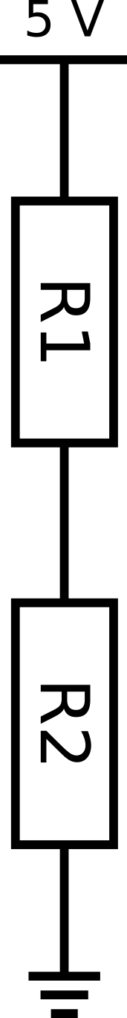
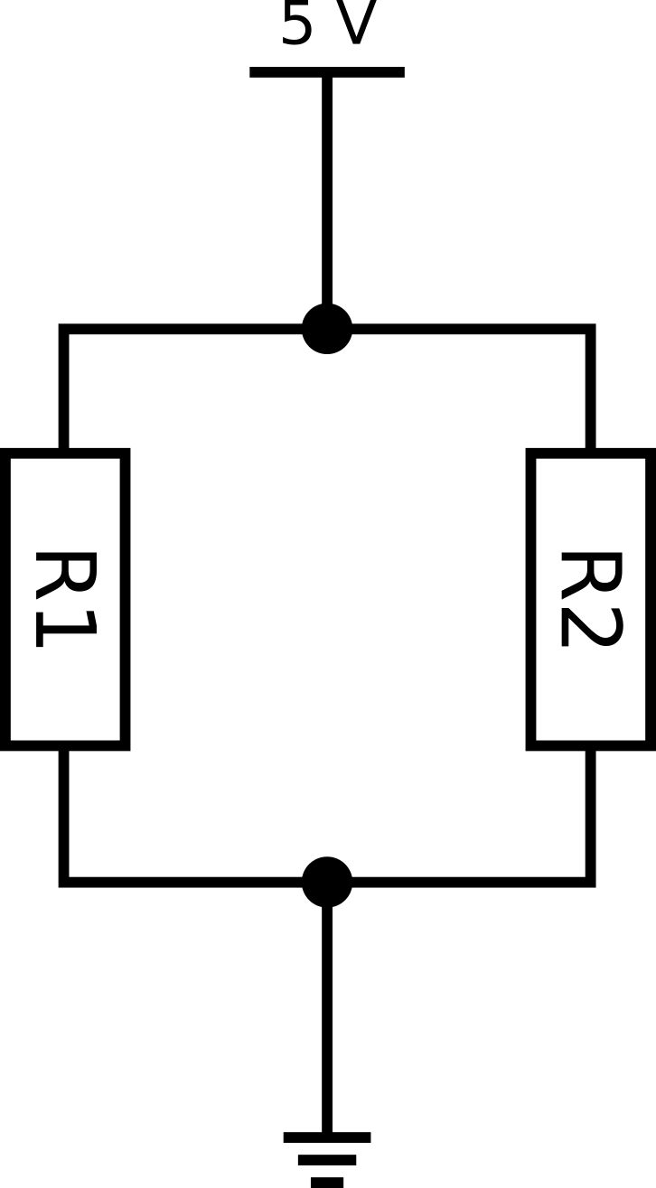
Parallel- and Series Connection
Series Connection
Parallel Connection

Slide 3
Series Connection
The total resistance R_{total} is the sum of all partial resistances in the series connection
The total voltage U_{total} is divided up into n partial voltages
The current I is the same at every point in the series connection
$R_{total}=R_{1}+R_{2}+...+R_{n}=\sum_{i=1}^{n}{R_{i}}$

Slide 4
$\frac{1}{R_{total}}=\frac{1}{R_{1}}+\frac{1}{R_{2}}+...+\frac{1}{R_{n}}=\sum_{i=1}^{n}{\frac{1}{R_{i}}}$
Parallel Connection
The reciprocal of the total resistance R_{total} is the sum of the reciprocals of all partial resistances in the parallel connection
The total current I_{total} is divided up into n partial currents
The voltage over every resistor connected in parallel is the same
$\frac{1}{R_{total}}=\frac{1}{R_{1}}+\frac{1}{R_{2}}+...+\frac{1}{R_{n}}=\sum_{i=1}^{n}{\frac{1}{R_{i}}}$

Slide 5
Voltage Divider
Series connection of resistors
Divides the total voltage into several smaller partial voltages
The ratio of the partial voltage over any resistor to the total voltage is proportional to the ratio of the partial resistance to the total resistance
Exercise: R1 = 100Ω, R2 = 400Ω → calculate U1
$\frac{U_{i}}{R_{i}}=\frac{U_{total}}{R_{total}}$
$U_{total}=U_{1}+U_{2}+...+U_{n}$

Slide 6
Any questions?

Slide 7
A red LED (~2 V) is supplied with power over a USB cable (5 V). In order to protect the LED from overvoltage, it is connected in series with a dropping resistor (220 Ω).
How can the circuit be changed to reduce the LED’s brightness?

Slide 8
How can an electric motor (9 V) be supplied with power only using AA batteries (1.5 V)?

Slide 9
The motor from the last tasks works now but the batteries are draining too fast. What can be changed to fix this problem?

Slide 10
How can twelve red LEDs (~2 V) be supplied with power only using a power supply with 5 V?

Slide 11
The dropping resistor used in the last example gets very hot. How can the circuit be changed to avoid this?

Slide 12
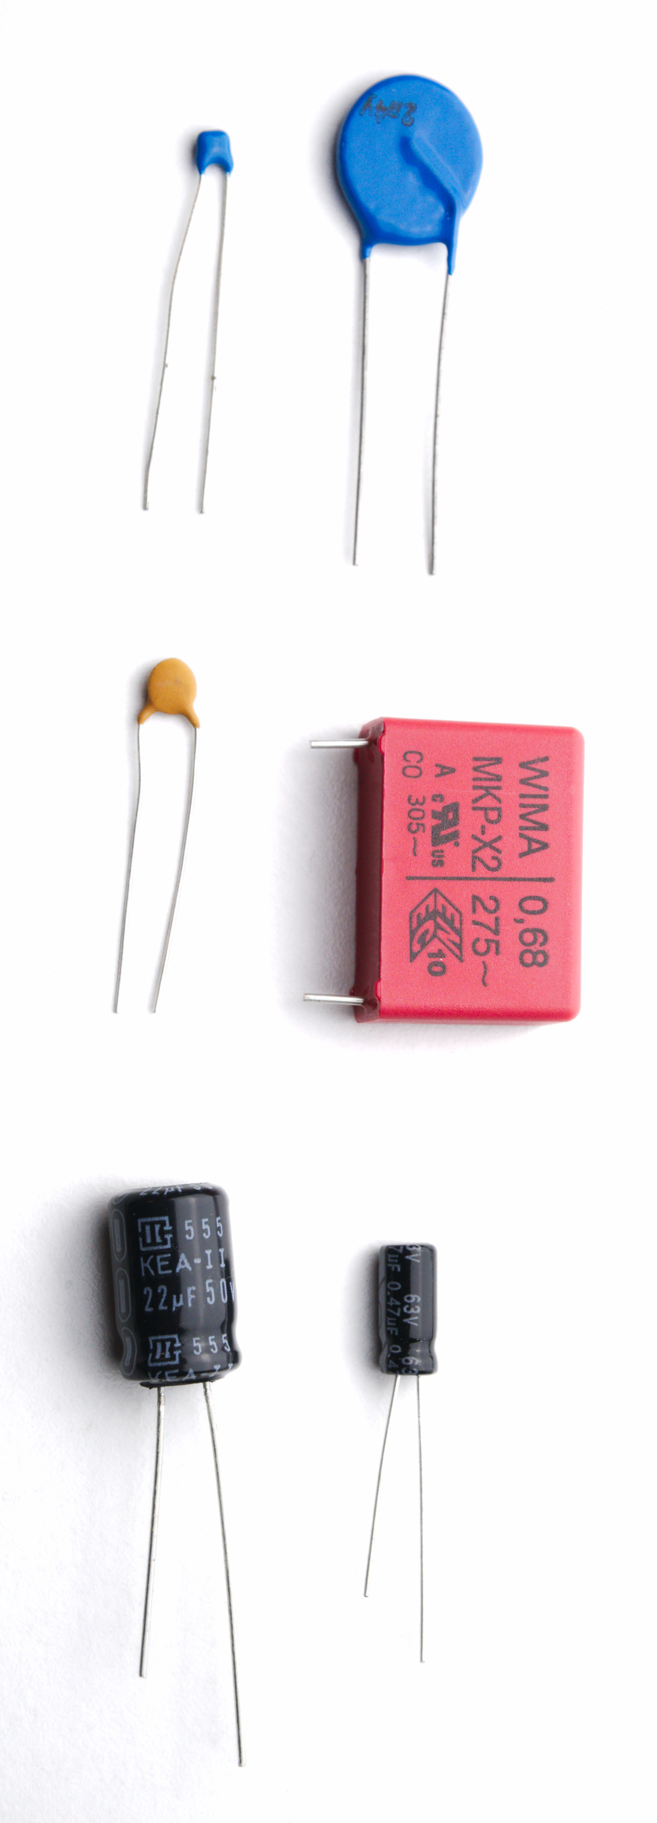
Capacitors
Stores electrical charge (Q)
Stored charge per Volt = Capacitance (C)
Unit of capacitance: Farad (F)
C = Q / U
Polarity is (sometimes) important!
Usage:
Store charge
filter noise from signals
compensate peaks in voltage

Slide 13
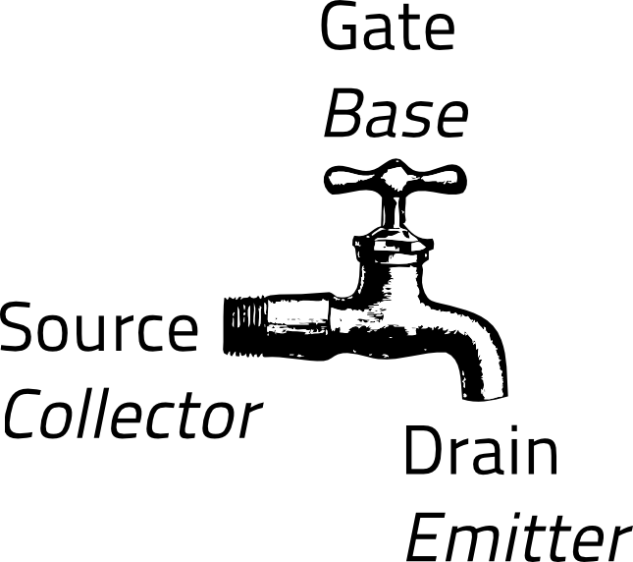
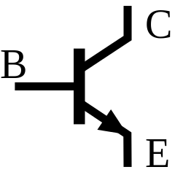
Transistor
Electronically controlled switch
If there is a voltage on the base, current can flow from collector to emitter
Application:
Switching large loads
Logic gates
Fundamental for digital circuits
TODO: Source
https://de.wikipedia.org/wiki/Datei:BJT_NPN_symbol-fr.svg

Slide 14
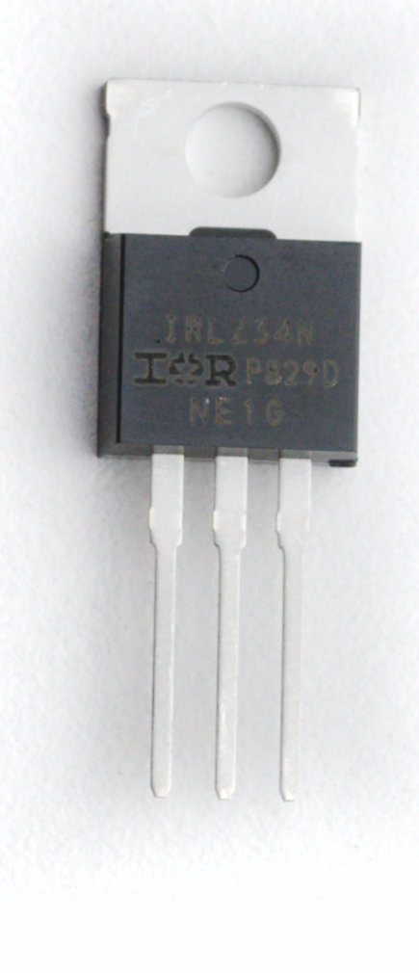
Transistor: MOSFET
Two types:
Normally open
Normally closed
Can be used like a voltage controlled resistor
Can switch large loads with a low voltage
G D S

Slide 15
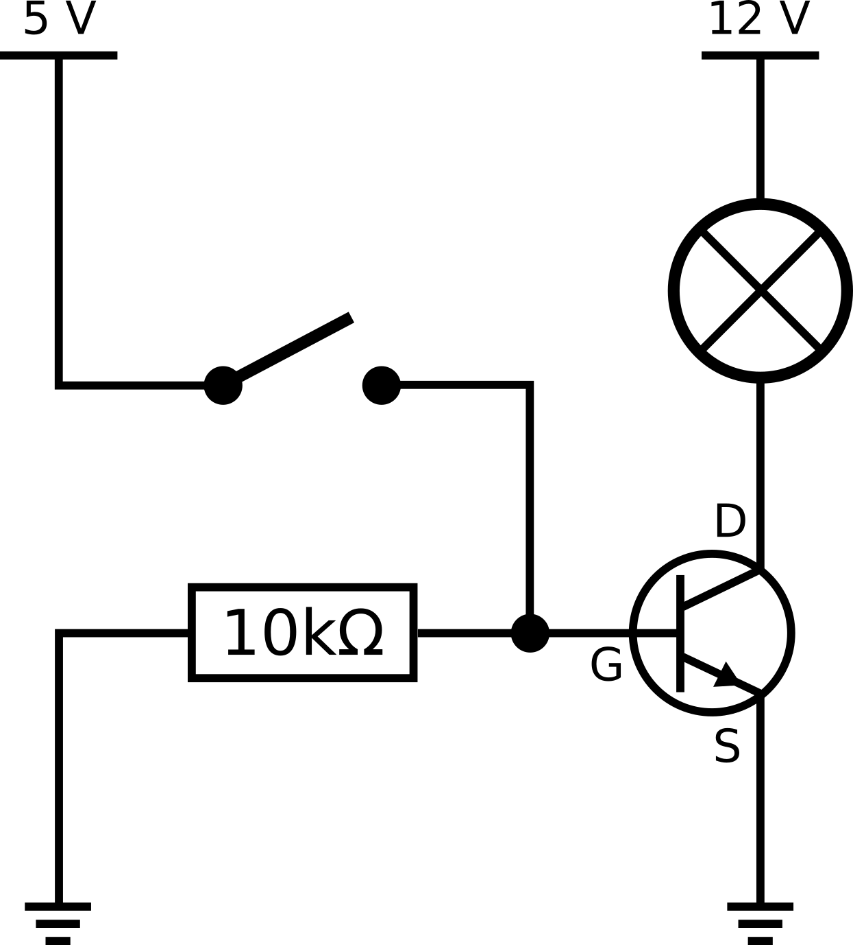
Switching a load with a MOSFET

Slide 16
Pull-Down Resistor
When the switch is closed, voltage can flow from 5 V over Gate and Source to GND
When the switch is opened again, there might still be potential between the switch and GND
→ Use a big resistor between Gate and GND so this voltage is pulled down to 0 V

Slide 17
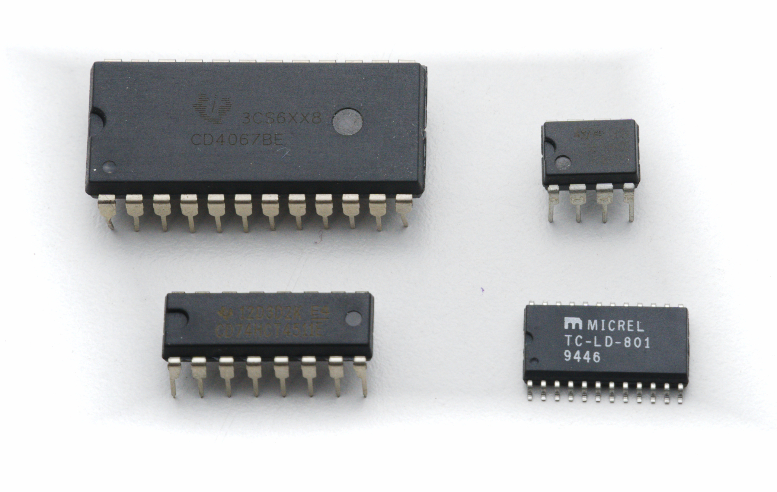
Integrated Circuits
Dedicated component that contains a certain circuit manufactured at a very small scale
May contain millions of transistors, capacitors and resistors
Used as a “black box”
Examples:
Logic gates, amplifiers, timers, registers,
memory, sensors, ...

Slide 18
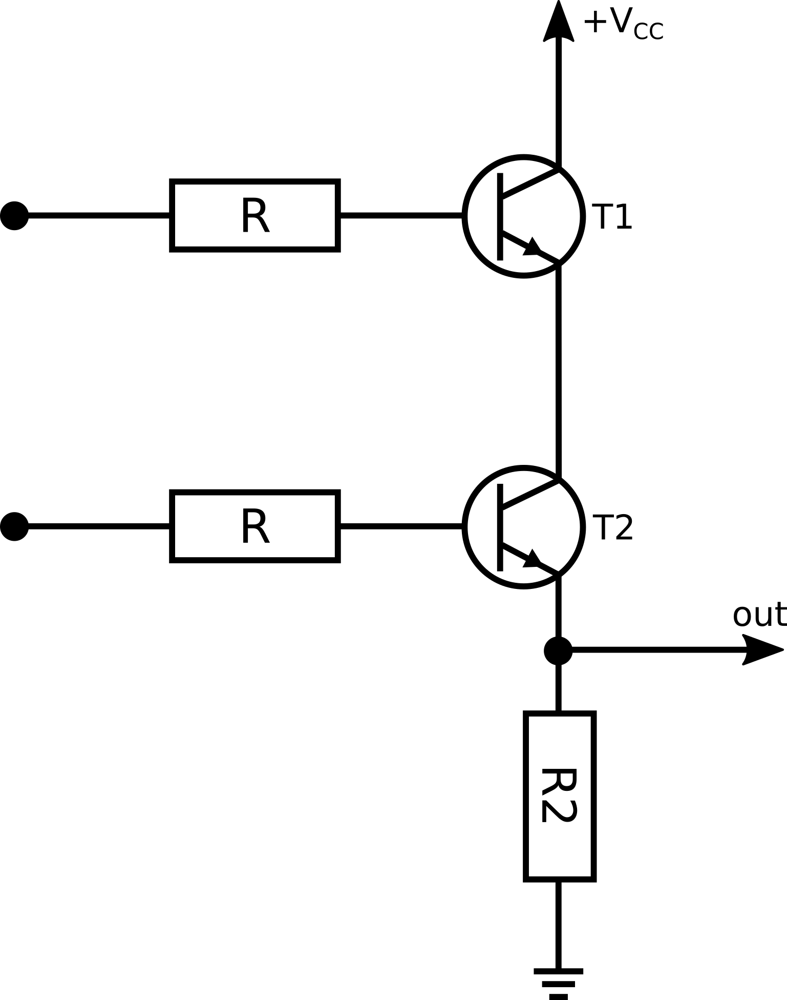
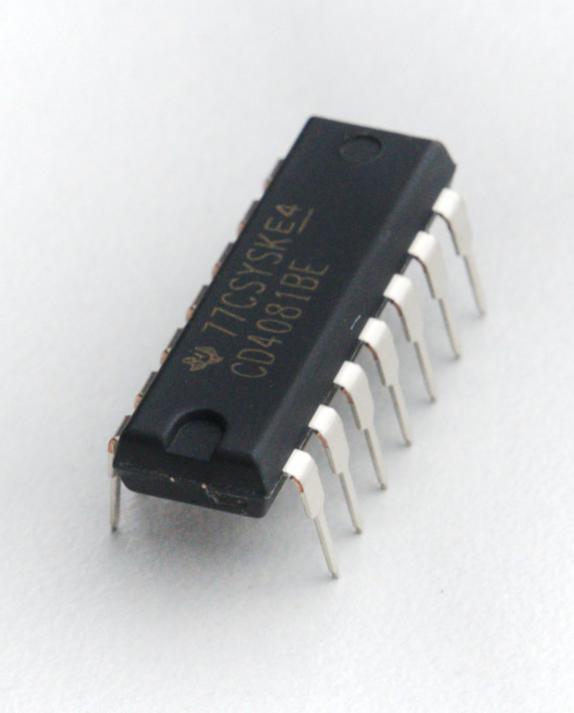
Example: The AND Gate
and(a, b){
if (a == 1)
and (b == 1):
return 1
else:
return 0
}

Slide 19
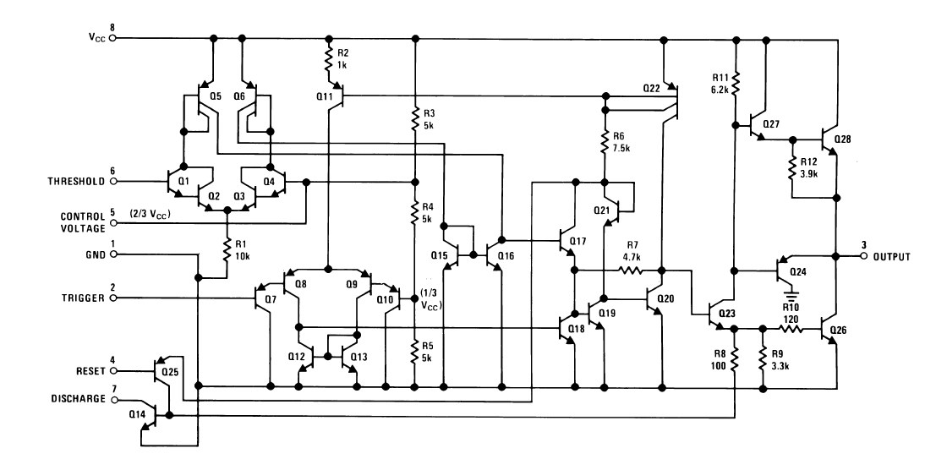
Example: LM555
Source: Texas Instruments LM555 Data Sheet

Slide 20
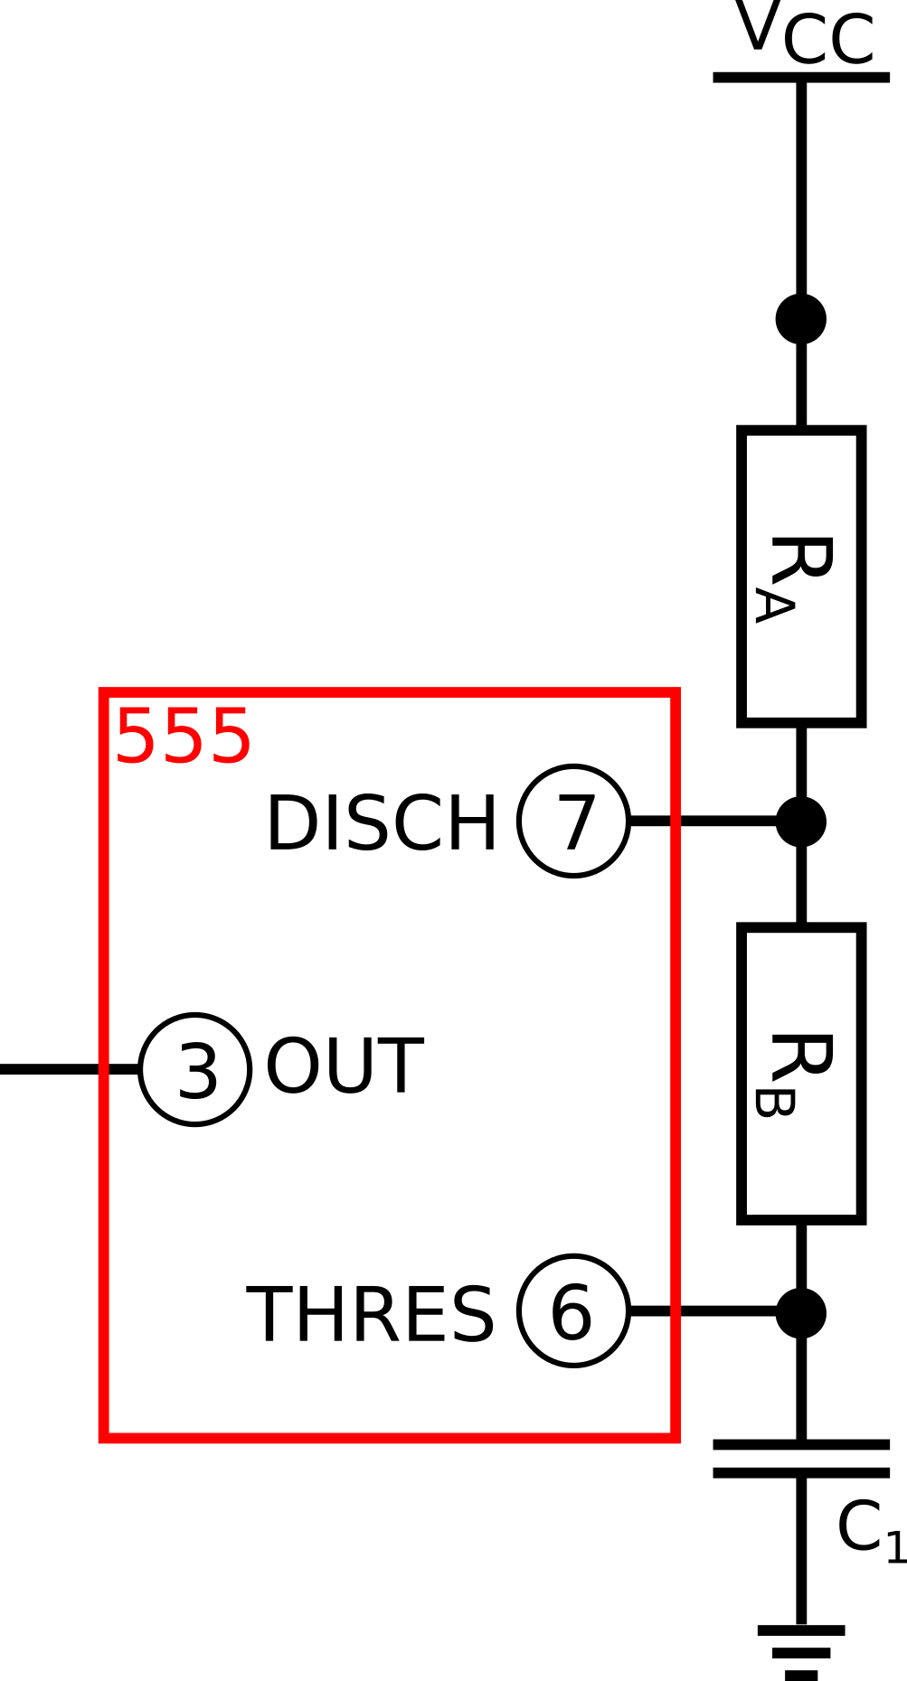
How does a 555 timer IC work?
Different modes – depending on the circuit connection
Basic principle: Charge a capacitor and do something when it’s fully charged. Example: astable multivibrator:
C₁ is charged. THRES measures the voltage at C₁.
→ the voltage at THRES starts at 0 V as all of the voltage is used to charge C₁. As C₁ gets charged, the voltage at THRES approaches V_{CC}
When the voltage at THRES reaches 2/3 of V_{CC}, DISCH is connected to GND. OUT is set to high (V_{CC}).
→ C₁ gets discharged
When the voltage at THRES reaches 1/3 of V_{CC}, DISCH is disconnected from GND. OUT is set to low (GND).
→ go to step 1

Slide 21
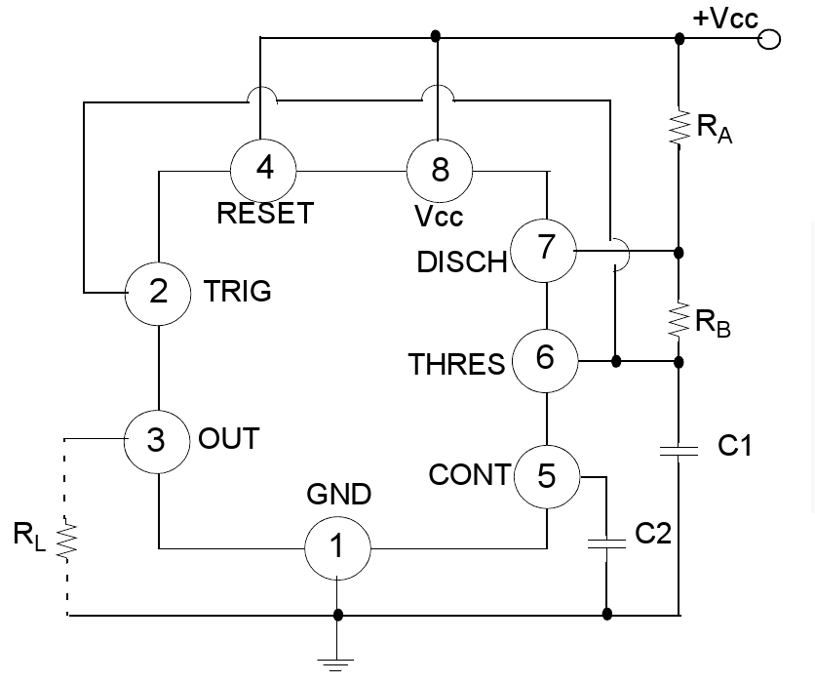
555: Astable Multivibrator
Source: Fairchild LM555 Data Sheet

Slide 22
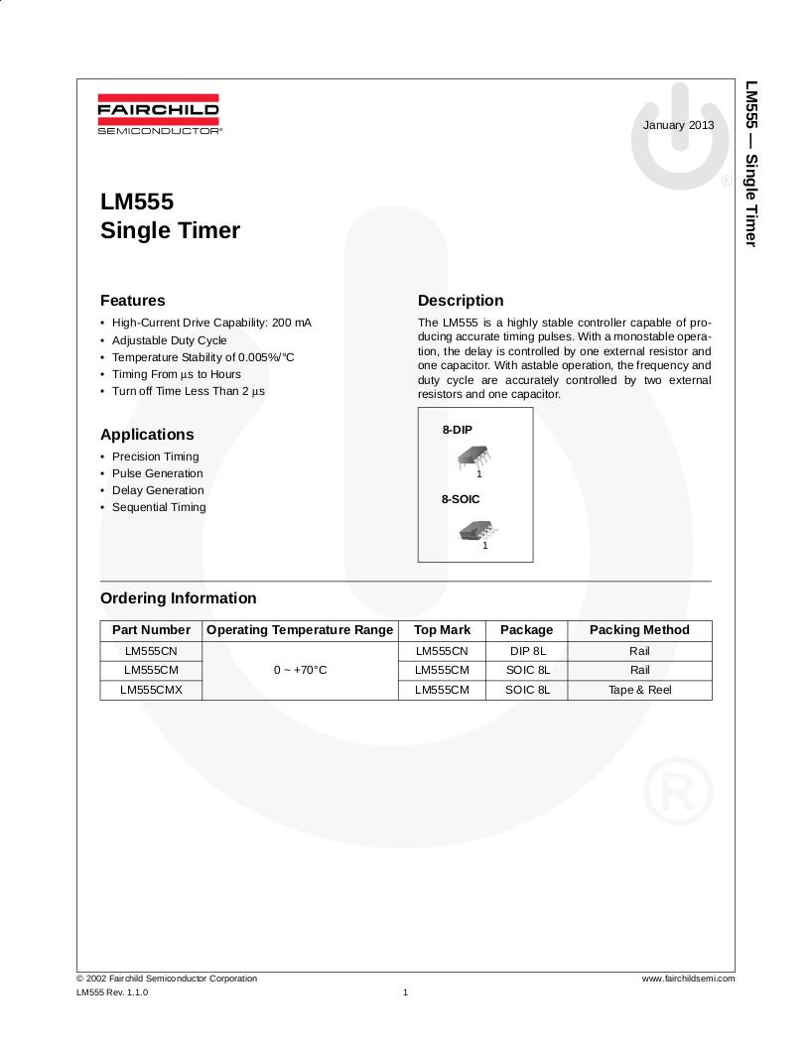
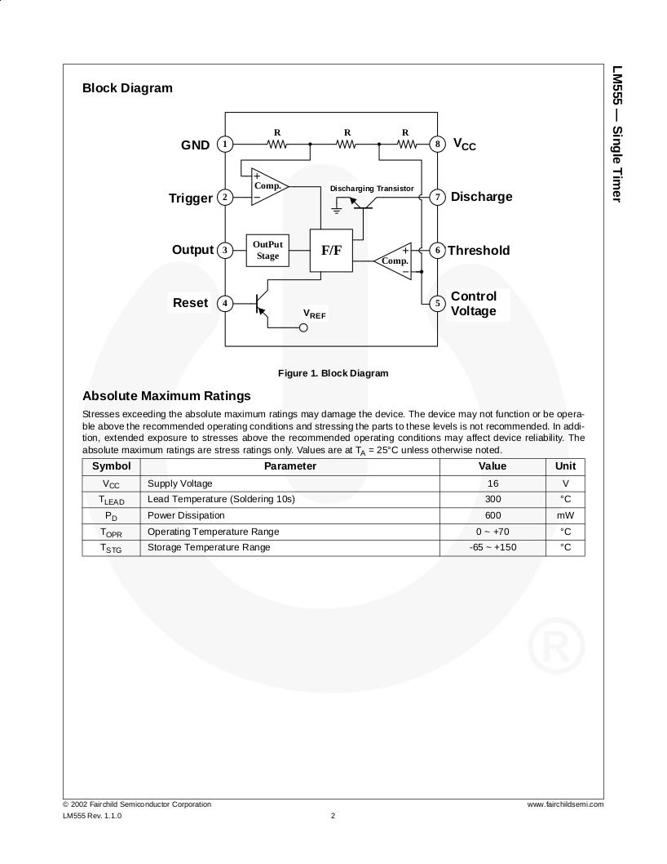
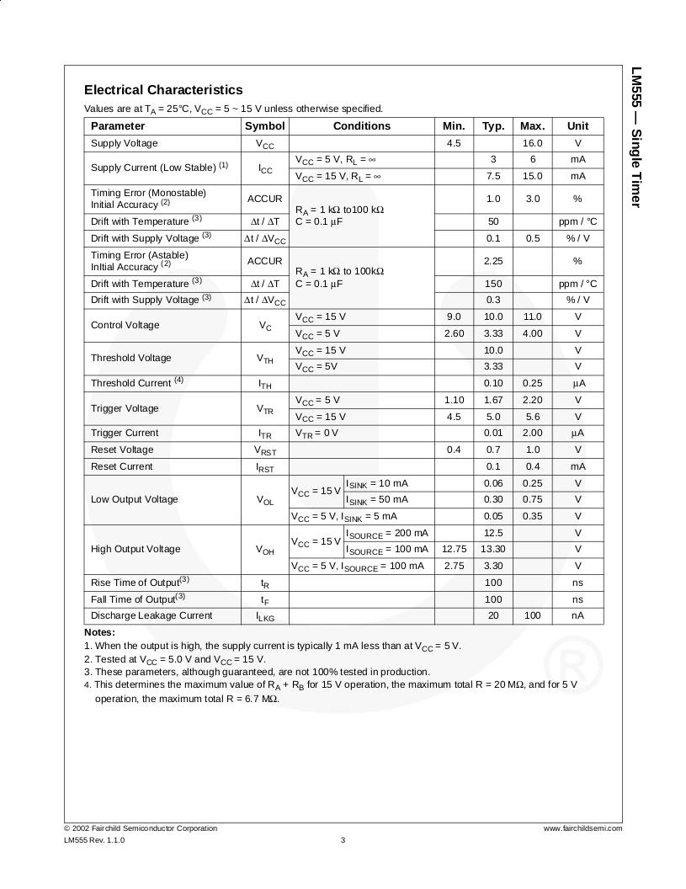
Reading Data Sheets
Source: Fairchild LM555 Data Sheet

Slide 23
Tutorial 03 – Electronics 02

